Slide 1
Logic in AI
Chapter 7
Session 11

Slide 2
Knowledge Representation
represent knowledge about the world in a manner that facilitates inferencing (i.e. drawing conclusions) from knowledge.
Example: Arithmetic logic
– x >= 5
In AI: typically based on
Logic
Probability
Logic and Probability
3

Slide 3
Basic Idea of Logic
By starting with true assumptions, you can deduce true conclusions.
6

Slide 4

Knowledge bases
Knowledge base = set of sentences in a formal language
Declarative approach to building an agent (or other system):
– Tell it what it needs to know
Then it can Ask itself what to do - answers should follow from the KB
Agents can be viewed at the knowledge level
i.e., what they know, regardless of how implemented
Or at the implementation level
i.e., data structures in KB and algorithms that manipulate them
9

Slide 5
Propositional Logic
Syntax
Atomic sentences: P, Q, …
Connectives: ∧ , ∨, ¬, →
Semantics
Truth Tables
Inference
Modus Ponens
Resolution
DPLL
GSAT

Slide 6
Propositional Logic: Syntax
Atoms
– P, Q, R, …
Literals
P, ¬P
Sentences
Any literal is a sentence
If S is a sentence
Then (S ∧ S) is a sentence
Then (S ∨ S) is a sentence
Conveniences
P → Q same as ¬P ∨ Q

Slide 7
Semantics
Syntax: which arrangements of symbols are legal
(Def “sentences”)
Semantics: what the symbols mean in the world
(Mapping between symbols and worlds)
Inference
Sentences
Sentences
Representation
World
Semantics
Semantics
Facts
Facts

Slide 8
Propositional Logic: SEMANTICS
“Interpretation” (or “possible world”)
Assignment to each variable either T or F
Assignment of T or F to each connective via defns
Q
Q
 | T | F
T | T | F
F | F | F
 | T | F
T | T | T
F | T | F
P
P
P ∧ Q
P ∨ Q

Slide 9
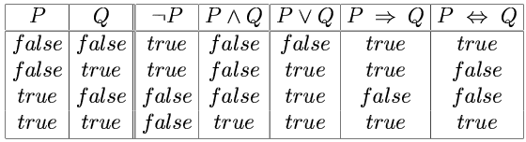
Truth tables for connectives

Slide 10
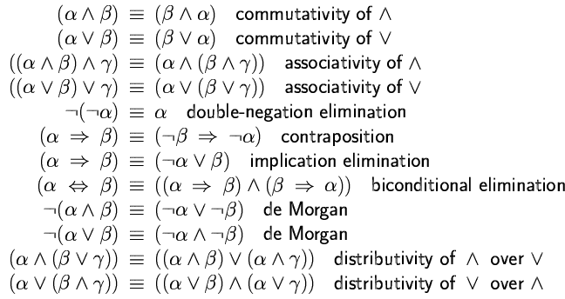
Logical equivalence (using truth table)
Two sentences are logically equivalent
iff true in same models: α ≡ ß iff α╞ β and β╞ α

Slide 11
Satisfiability, Validity, & Entailment
S is satisfiable if it is true in some world
S is unsatisfiable if it is false in all worlds
S is valid if it is true in all worlds
S1 entails S2 if wherever S1 is true S2 is also true

Slide 12
Examples
P → Q
R → ¬R
S ∧ (W ∧ ¬S) T ∨ ¬T
X → X

Slide 13
Notation
⇒
⊃
→
⎟−
⎟=
}
Implication (syntactic symbol)
Proves:
Entails:
S1 |-_{ie} S2 if `ie’ algorithm says `S2’ from S1
S1 |= S2 if wherever S1 is true S2 is also true
⎟− → ⎟=
⎟= → ⎟−
Sound
Complete
16

Slide 14
Reasoning Tasks
Model finding
KB = background knowledge S = description of problem Show (KB ∧ S) is satisfiable
A kind of constraint satisfaction
Deduction
S = question
Prove that KB |= S Two approaches:
Rules to derive new formulas from old (inference)
Show (KB ∧ ¬ S) is unsatisfiable

Slide 15
Special Syntactic Forms
General Form:
((q∧¬ r) → s)) ∧ ¬ (s ∧ t)
Conjunction Normal Form (CNF)
(¬ q ∨ r ∨ s ) ∧ (¬ s ∨ ¬ t)
Set notation: { (¬ q, r, s ), (¬ s, ¬ t) } empty clause () = false
Binary clauses: 1 or 2 literals per clause
(¬ q ∨ r) (¬ s ∨ ¬ t)
Horn clauses: 0 or 1 positive literal per clause
(¬ q ∨ ¬ r ∨ s ) (q∧r) → s
(¬ s ∨ ¬ t) (s∧t) → false

Slide 16
Propositional Logic: Inference
A mechanical process for computing new sentences
Backward & Forward Chaining
Resolution (Proof by Contradiction)
SAT
Davis Putnam
WalkSat

Slide 17
Inference 1: Forward Chaining
Forward Chaining
Based on rule of modus ponens
If know P1, …, Pn & know (P1 ∧... ∧ Pn ) → Q Then can conclude Q
Backward Chaining: search
start from the query and go backwards

Slide 18
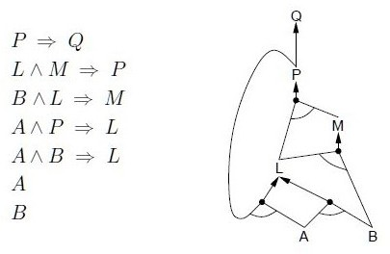
Example : Prove Q is true
1
2
2
2
2

Slide 19
Example
1
2
2
1
1

Slide 20
Example
1
2
1
1
0

Slide 21
Example
1
2
1
1
0

Slide 22
Example
1
1
0
1
0

Slide 23
Example
1
1
0
1
0

Slide 24
Example
1
0
0
1
0

Slide 25
Example
0
0
0
0
0

Slide 26
Example
0
0
0
0
0

Slide 27
Backward chaining
Idea: work backwards from the query q:
to prove q by BC,
check if q is known already, or
prove by BC all premises of some rule concluding q
Avoid loops: check if new subgoal is already on the goal stack
Avoid repeated work: check if new subgoal
has already been proved true, or
has already failed

Slide 28
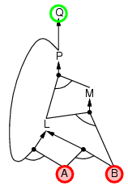
Backward chaining example

Slide 29
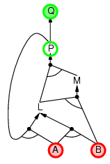
Backward chaining example

Slide 30
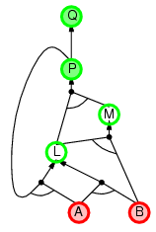
Backward chaining

Slide 31
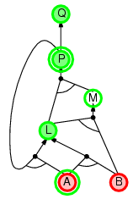
Backward chaining example

Slide 32
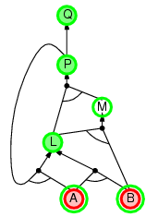
Backward chaining example

Slide 33
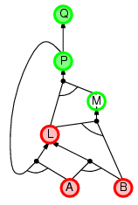
Backward chaining example

Slide 34
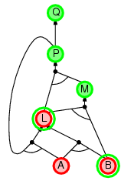
Backward chaining example

Slide 35
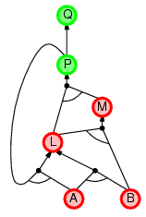
Backward chaining example

Slide 36
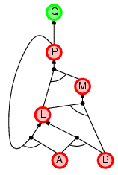
Backward chaining example

Slide 37
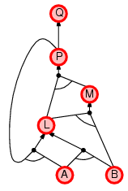
Backward chaining example

Slide 38
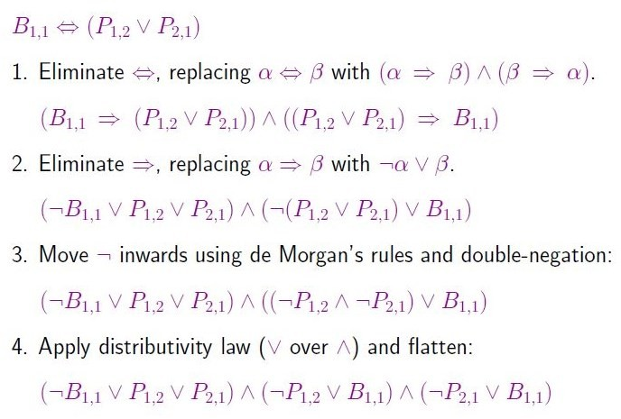
Conversion to CNF

Slide 39
Inference 2: Resolution
[Robinson 1965]
{ (p ∨ α), (¬ p ∨ β ∨ γ) } |-_{R} (α ∨ β ∨ γ)
Correctness
If S1 |-_{R} S2 then S1 |= S2
Refutation Completeness:
If S is unsatisfiable then S |-_{R} ()

Slide 40
Resolution subsumes Modus Ponens
A → B, A |= B
(¬ A ∨ B)
(A)
(B)

Slide 41
If Will goes, Jane will go
~W V J
If doesn’t go, Jane will still go
W V J
Will Jane go?
|= J?
J V J =J
Don’t need to use other equivalences if we use resolution in refutation style
~J
~W V J W V J
~W
J

Slide 42
Resolution
If the unicorn is mythical, then it is immortal, but if it is not mythical, it is a mammal. If the unicorn is either immortal or a mammal, then it is horned.
Prove: the unicorn is horned.
(¬ A ∨ H)
(¬ H)
(¬I ∨ H)
M = mythical I = immortal A = mammal H = horned
(M ∨ A)
(¬A)
(¬I)
(¬ M ∨ I)
(M)
(¬ M)
()
36

Slide 43
Search in Resolution
Convert the database into clausal form D_{c}
Negate the goal first, and then convert it into clausal form D_{G}
Let D = D_{c}+ D_{G}
Loop
Select a pair of Clauses C1 and C2 from D
Different control strategies can be used to select C1 and C2 to reduce number of resolutions tries
Resolve C1 and C2 to get C12
If C12 is empty clause, QED!! Return Success (We proved
the theorem; )
– D = D + C12
Out of loop but no empty clause. Return “Failure”
Finiteness is guaranteed if we make sure that:
we never resolve the same pair of clauses more than once;
we use factoring, which removes multiple copies of literals from a clause (e.g. QVPVP => QVP)

